Slide 1


Technical Writing and Presentation Writing scientific text in computer science
TRƯỜNG ĐẠI HỌC BÁCH KHOA HÀ NỘI
HANOI UNIVERSITY OF SCIENCE AND TECHNOLOGY
SOICT - 2020

Slide 2
Scientific Writing for Computer Science
How to write scientific texts in computer science?
How to write in English?
How to write a technical report / thesis?

Slide 3
Contents
General style
References and citations
Acknowledgements
Formatting
Use of tables, figures, and similar elements.
Mathematics

Slide 4
General style
What is style?
Scientific writing style

Slide 5
Genre (style)
The manner of expression is the writing style: how well you communicate with likely readers.
Scientific writing must be plain and straightforward but not dull. It can have style.
Good style makes your writing easy to understand. It can persuade readers that work is of value.
Notes:
Science writing must by its nature be plain and straightforward—the need for it to be accurate and clear makes poetry inappropriate.
But this does not mean that science writing has to be dull. It can have style, and moreover the desire to communicate clearly is not the only reason to make good use of English. Lively writing suggests a lively mind with interesting ideas to discuss

Slide 6
Scientific writing style
Fundamental aims of science writing: to be exact, clear, and compact.
Compact is usually clear!
Other desirable properties: smooth and objective

Slide 7
Exact
Word choice
Avoid vague expressions which are typical for the spoken language
Make clear what the pronouns refer to
Avoid ambiguity
Avoid illogical comparisons
Correct grammar

Slide 8
Avoid ambiguity
Example
✗An inverted list for a given term is a sequence of pairs, where the first element in each pair is a document identifier and the second is the frequency of the term in the document to which the identifier corresponds.
✓An inverted list for a term t is a sequence of pairs of the form
(d, f) where each d is a document identifier and f is the frequency of t in d
Many terms have well-defined mathematical meanings and are confusing if used in another way.
For example,
Formula, expression, equation
Average, mean
Subset, proper subset, strict subset.
Notes:
Formula, expression, equation. A “formula”, or an “expression” is not necessarily an “equation”; the latter involves an equality.
Average, mean. “Average” is used loosely to mean typical. Only use it in the formal sense—of mean, that is, the arithmetic mean—if it is clear to the reader that the formal sense is intended. Otherwise use “mean” or even “arithmetic mean”
Subset, proper subset, strict subset. “Subset” should not be used to mean subproblem. Orderings (or partial orderings) specified in writing are assumed to be non-strict. For example, “A is a subset of B” means that A ⊆ B; confusingly, this is sometimes written A ⊂ B. To specify A B use “A is a proper (or strict) subset of B”

Slide 9
Use Words Efficiently
Never use two words when one word will do.
Example 1: The relationship between the nature of salt water to fresh water in the Edgartown Great Pond that fluctuates often is extremely important to everyone including scientists, residents, and environmentalists on Martha’s Vineyard.
Example 2: The fluctuating salinity of EGP concerns many environmentalists, scientists, and residents.

Slide 10
Clear
Use illustrative titles which describe the essential in a chapter or a section.
Write a brief introductory paragraph in the beginning of each chapter or section with subsections.
Divide the text logically into sentences and paragraphs.
Place the adjective or the adverb as close as possible to the word it modifies.
Avoid scientific jargon = continuous use of technical vocabulary when it is not relevant.
Write numbers as digits when they refer to sizes or exact measurements.
Use punctuation to support meaning.
Notes:
– Direct, declarative sentences with simple, common words are usually best. – Paragraphs should be logically uniform and continuous– Direct, declarative sentences with simple, common words are usually best. – Paragraphs should be logically uniform and continuous
Otherwise the general rule is to write numbers < 10 as words. Express decimal numbers with a suitable precision. See APA pp. 122-129.

Slide 11
Avoid jargon
Jargon: a vocabulary particular to a place of work (abbreviations, slang)
Audience familiarity with the topic determines appropriate use of jargon
✗ For the first year, the links with SDPC and the HAC were not connected, and all required OCS input data were artificially loaded. Thus CATCH22 and MERWIN were not available.
✓Because some of the links in the computer system were not connected the first year, we could not run all the software codes.
Notes:
Jargon: biệt ngữ, từ khó hiểu

Slide 12
Define the Unfamiliar
If you must abbreviate, define the term in its first occurrence, and put abbreviations in parentheses
Example: Edgartown Great Pond (EGP) is a vital body of water. Unfortunately, due to an unpredictable influx of saltwater, the delicate ecosystem is in danger of destabilizing.
Italicize first occurrence of unfamiliar terms and define them right away Example Retina is a light-sensitive tissue, found at the back of the eye, that converts light impulses to nerve impulses.

Slide 13
Compact
Say only what needs to be said!
Short words and short sentences are always easier to comprehend
Weed out too detailed descriptions.
Don’t describe irrelevant or trivial observations
Avoid wordiness, Use no more words than are necessary. Redundant words and phrases should be omitted.
Avoid too long sentences and paragraphs
Notes:
Cô đọng
3/E.g. when you describe previous work, avoid unnnecessary details. Give a reference to a general survey or a review if available.
5/e.g. ”based on the fact that” → ”because” ”at the present time” → ”now” ”for the purpose of ” → ”for/to sg.” Notice: ”reason” and ”because” have the same meaning → don’t use together!
6/which have no new information)

Slide 14
Smooth
Verbs: Stay within the chosen tense! No unnecessary shifts in verb tense within – the same paragraph – in adjacent paragraphs
Use verbs rather than their noun equivalents
Prefer active to passive voice
Avoid long noun strings!
Each pronoun should agree with the referant in number and gender.
Transitional words help to maintain the flow of thought
Notes:
4/Hint: sometimes you can move the last word to the beginning and fill in with verbs and prepositions
6/time links: then, next, after, while, since
cause-effect links: therefore, consequently, as a result
addition links: in addition, moreover, furthermore, similarly
contrast links: but, however, although, whereas

Slide 15
Smooth
Notice: some transitional words (while, since) can be used in several meanings → limit their use to their temporal meaning!
Use abbreviations sparingly, especially the abbreviations which you define yourself for technical terms.
Do not use emphasis (italics) when it is not needed. Use syntax to provide emphasis.
Metaphors can sometimes help to simplify complex ideas. However, – Avoid overuse metaphors and cliches
Notes:
Mục 1/(Use ”because” instead of ”since”; ”although”, ”whereas” or ”but” instead of ”while”, when there is no time connection.)
Metaphor: Ẩn dụ, dung việc này để nói về việc khác. Ví dụ LOVE IS A JOURNEY.Cliché: lời nói sáo, câu nói rập khuôn.

Slide 16
Active voice
Use direct statements and expressions involving “we” or “I”—that is, the active voice—to make reading more pleasant and to help distinguish new results from old.

Slide 17
Example: active voice vs passive voice
✗The results show that, for the given data, less memory is likely to be required by the new structure, depending on the magnitude of the numbers to be stored and the access pattern.
✓The results show that less memory was required by the new structure. Whether this result holds for other data sets will depend on the magnitude of the numbers and the access pattern, but we expect that the new structure will usually require less memory than the old.

Slide 18
References and Citations
References and citations
explain the relationship of your new work to existing works.
how your work was built on previous knowledge and how it differs from contributions in other paper
References must be in standardized format

Slide 19
Purposes of references
Demonstrate that your work is new
Demonstrate your knowledge of the research area
Help the reader to judge whether your statements are reliable.
Pointers to background reading.

Slide 20
An appropriate reference is
Relevant
up-to-date
reasonably accessible
Refer to the original paper
well-written material
book, conference paper, journal article in preference to a workshop paper
workshop paper in preference to a manuscript
formally published documents rather than Web pages
Avoid reference to private communications and information provided in seminars or talks
Don’t cite to support common knowledge.
Notes:
If you discuss a paper or note some particular contribution it makes, it must be cited. Otherwise, consider whether a reader needs the paper for knowledge in addition to that in the other papers you cite.
If the answer is no, perhaps it should be omitted. Common knowledge example: binary tree.

Slide 21
Examples
Refer to a result in an inaccessible paper, do not refer to it directly:
According to Kelly (1959; as quoted by Dawson 1981), stable graphs are closed
When you use results from other papers, be sure to show the relationship to your own work:
Marsden [16] has used an approach in which… Other work (Marsden 1991) has used an approach in which…
Notes:
For example, a reference might show a general case, but you use a special case; then you need to show that it is a special case

Slide 22
Citations
Citations should be punctuated
Never treat a bracketed expression, whether a citation or otherwise, as a word.
✗In [2] such cases are shown to be rare.
✓Such cases have been shown to be rare [2].

Slide 23
Citations
The cite should be close to the material it relates to
✗The original algorithm has asymptotic cost O(n²) but low memory usage, so it is not entirely superseded by Ahlberg’s approach, which although of cost O(n log n) requires a large in-memory array (Ahlberg 1996; Keele 1989)
✓The original algorithm has asymptotic cost O(n₂) but low memory usage (Keele 1989). Thus it is not entirely superseded by Ahlberg’s approach (Ahlberg 1996), which, although of cost O(n log n), requires a large in-memory array
Notes:
poor placement of cites can be ambiguous.
Since Ahlberg did not recognize the array as a problem and does not describe the old approach, this sentence is misleading

Slide 24
Acknowledgements
Should thank everyone who made a contribution, whether advice, proofreading, coding, or whatever
Two common forms of acknowledgement
list the people who have helped
explain each person’s contribution
Write “I am grateful to” , “I thank” or “Thanks to” instead of “I would like to thank” or “I wish to thank”

Slide 25
Formatting
Fonts
Indentation
Layout
Headings
Numbering

Slide 26
Fonts
Standard choices: Times New Roman, Cambria.
Three fonts for computing and mathematical writing : plain, italic, bold
Underlining is used for emphasis.
Notes:
Overuse offonts results in messy-looking text

Slide 27
Indentation
Indentation is used to indicate the start of a new paragraph
Use right-justified as well as left-justified
Pages should be numbered

Slide 28
Layout
The appearance of a report is no less important than its content.
An attractive, clearly organised report stands a better chance of being read.
Use a standard, 12pt, font, such as Times New Roman, for the main text.
Use different font sizes, bold, italic and underline where appropriate but not to excess.
Too many changes of type style can look very fussy.

Slide 29
Headings
Use heading and sub-headings to break up the text and to guide the reader.
They should be based on the logical sequence which you identified at the planning stage but
With enough sub-headings to break up the material into manageable chunks.

Slide 30
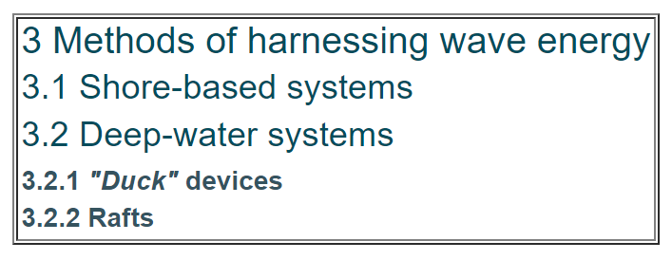
Numbering
The use of numbering and type size and style can clarify the structure as follows;

Slide 31
Use of tables, figures, and similar elements
Figures and tables
Diagrams
Graphs
Lists
Algorithms
Examples and definitions
Equations

Slide 32
Figures and tables
General rules
Vector graphics
Captions
Expressions

Slide 33
General rules
Figures illustrate the models or the results, and tables give summaries.
Two rules for displaying figures and tables
All figures and tables must be referred in the text.
There is no sense to express trivial things as a figure or a table
If there is no need to refer to a figure/table in the text, the figure/table is probably not needed!
Avoid repeating the same data in several places.
Discuss only the most important items of the table in the text.
A figure should be easy to understand..
If two tables/figures should be compared, position them next to each other.
Notes:
2 trong mục 1. (e.g. a table, which contains only two lines)
Mục 3:An informative table or figure supplements rather than duplicates the text. Refer to all tables/figures, and tell the reader what to look for.
Mục 5 Do not present any unnecessary details

Slide 34
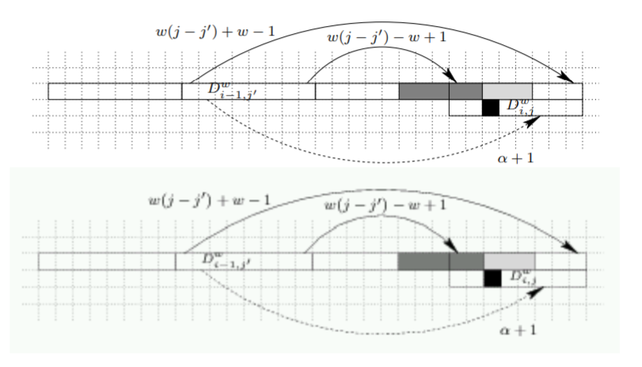
Vector graphics
Use vector graphics, not raster graphic (bitmaps)! There is a big difference in quality:
Notes:
(The bitmap file was also about 30 times larger!)

Slide 35
Tables
Is a table the best way to present your information?
Consider graphs, bar charts or pie charts.
Dependent tables (small) can be placed within the text, even as part of a sentence.
Independent tables (larger) are separated from the text with table numbers and captions. Position them as close as possible to the text reference.
Complicated tables should go in an appendix.

Slide 36
Captions
Each table or figure should be understandable by its own. Give a brief but clear explanation or a title in the caption.
Explain all special abbreviations, symbols, special use of underlinings, dashes, parantehses, etc.
Use the same style in all tables.
If you copy (draw again) a table or a figure from some other source, then give a reference to the original source in the end of caption.
Notes:
Mục 3 If you use abbreviation stdev for standard deviation in one table, then do not use sd in another table.
Mục 4 , e.g. ”Table 5. Plaa-plaa-plaa. Note. From [ref].” A page number is needed, if the table or figure is from a book

Slide 37
Expressions
When you refer to figures and tables you can use the following expressions:
The results are summarized/reported in Table 1
The results are represented in
Figure 2 illustrates
In the Figure we observe
The model is given in Figure 7
etc.

Slide 38
Diagrams
Keep them simple.
Draw them specifically for the report.
Put small diagrams after the text reference and as close as possible to it.
Think about where to place large diagrams.
Notes:
It is often the case that technical information is most concisely and clearly conveyed by means other than words. Imagine how you would describe an electrical circuit layout using words rather than a circuit diagram. Here are some simple guidelines;

Slide 39
Graphs
Graphs must be used particularly when trends are shown or series of data are compared.
Graphs containing data that need to be compared must be combined in the same figure so that the reader can make a direct comparison between the values.
The quantity of information in one graph must be limited so that the different symbols can be clearly distinguished.
The axes of a graph must be named in words, in conjunction with units.

Slide 40
Lists
Lists are not separate objects, and they are introduced in the text.
Use list only when they are necessary!
E.g. ”The main criteria of X are (the following):”
– Criterion 1
– Criterion 2 – ...
Or ”The method consists of five steps:” + a list
If you list only a couple of items, you can usually write them without a list. Use lists when the clarify things!

Slide 41
Algorithms
Give only the main algorithms in the text, and in an appropriate abstraction level (pseudocode)
Fix the pseudocode notation and use it systematically
Simple methods can be described by a numerated list of steps
Logical and set operations are often useful when you describe algorithms in an abstract level
E.g. for all x_{i} ∈ X, T = T ∪ {p_{i}}, find such S ⊆ T that q(S),...
If you writer longer algorithms, insert them into a figure or an environment of their own.”
Notes:
Mục 5.they can be referred like tables and figures: ”The EM algorithm for probabilistic clustering in given in Alg. 1

Slide 42
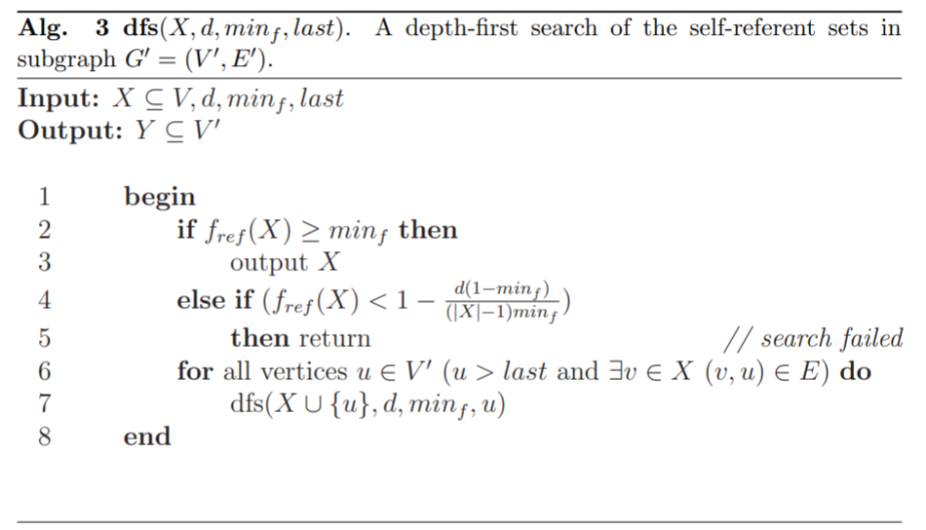
Example of Algorithm

Slide 43
Definitions
A good definition
explains the defined concept.
is not a circular argument (where x is defined by y and y by x).
is not expressed by negative terms, if possible.
doesn’t contain unclear, vague, or descriptive language •
defines only what is needed
Notes:
Mục 3 của 1
(Sometimes you cannot avoid this. E.g. statistical dependency is defined by statistical independency, because independency can be defined unambiguously.)
Mục 4 của 1
(i.e. is exact).
Mục 5 của 1
(i.e. the scope is restricted).

Slide 44
Expressions for referring to a definition
The definition of ... is the following:
The definition of ... is as follows:
Formally, we define …

Slide 45

Equations
Without equation numbers
Remember the full stop in the end of the equation, if the sentence finishes!
“The prior probability of X is updated by Bayes rule, given new evidence Y :
”
If the sentence continues, then you need comma:
”The dependency is described by equation
< equation >,
where a is sg. and b is sg.”
Notes:
Xác suất tiên nghiệm của X được cập nhật bởi luật Bayes với bằng chứng mới Y.
sg=segment

Slide 46
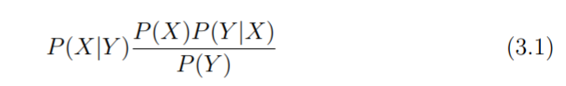
Equations
With equation numbers
If you want to refer to some previous equation, you have to give it a label like for examples.
Notes:
Xác suất tiên nghiệm của X được cập nhật bởi luật Bayes với bằng chứng mới Y.
sg=segment

Slide 47
Mathematics
Only use mathematics where it is the most efficient way to convey the information.
Longer mathematical arguments, if they are really necessary, should go into an appendix.

Slide 48
Mathematics (continued)
Mathematical notation can be used to describe algorithms, data structures, automata, or any of the objects in computer science
A lot of difficulties for readers if the mathematics is badly presented
There are conventions of presentation for mathematics and mathematical concepts.

Slide 49
Theoremes
Details of the proof can often be omitted in a paper.
Theorems, definitions, lemmas, propositions and key examples should be numbered.
If the proof need lemmas, put them at the right place for readability.
When stating your proof in a paper, Use means to convey your argument with the greatest possible clarity
Notes:
Not only does numbering allow reference within the paper, but it simplifies discussion of the paper later on. It is much easier for a correspondent to refer to “Definition 4.2” than “the definition towards the bottom of page 6”.
For a theorem with a complex proof, if the lemmas are proved early they appear irrelevant, and if they are proved late the main proof is harder to understand. One approach is to state the main theorem first, then state and prove the lemmas before giving the main proof
a diagram, for example, is perfectly acceptable. The end of each proof, example, or definition can be marked with a symbol such as a box

Slide 50
Readability
Mathematics is usually presented in italics, to distinguish it from other text.
If a displayed formula is sufficiently important it should be numbered,
Notations should follow the conventions of your area rather than invent your own.
Use appropriate brackets, braces, parenthesis
Sentences should begin with a word, not digits or mathematics
Do not use a long stream of complex expression
Avoid unnecessary subscripts

Slide 51
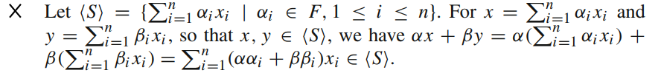
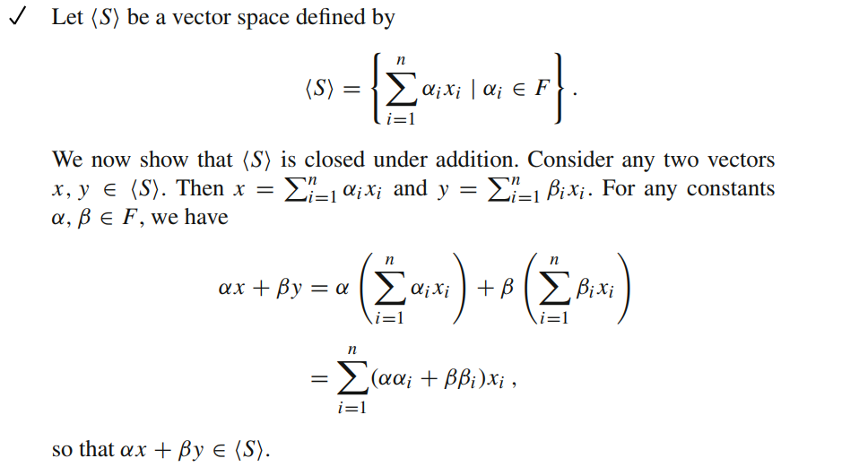
Example
Should be replaced with

Slide 53
Lecture materials derived from:
Justin Zobel (2014), Writing for Computer Science, Springer.
Wilhelmiina Häamäläinen(2006), Scientific Writing for Computer Science Students, Course material, University of Joensuu.
Nicole Kelley (2006), Basics of Technical Writing, slides of MIT course.

